Slide 1
Semantic Interoperability in FHIR
Minor Project
By
Harsh Kumar (2K14/CO/041)
Krittika Pal(2K14/CO/052)

Slide 2
Contents
Introduction
About HL7
Interoperability
Syntactic
Semantic
Version 2
Version 3
FHIR
Features of FHIR
RESTful APIs
Resources
The Epilepsy example
Conclusion and Future Scope

Slide 3
Introduction
About Electronic Health Records
Longitudinal health record with complete patient medical history
Supports care related activities
evidence-based decision support
quality management
outcomes reporting
Privacy and security of patient data
Notes:
History-patient demographics, progress notes, problems, medications, vital signs, past medical history, immunizations, laboratory data and radiology reports
Related activities-

Slide 4
About HL7
set of international standards
clinical and administrative data
Software applications of healthcare providers
All systems should communicate with each other
to easily share clinical information
flexible standards, guidelines, and methodologies
Notes:
Hospitals and other healthcare provider organizations typically have many different computer systems used for everything from billing records to patient tracking. All of these systems should communicate with each other (or "interface") when they receive new information, or when they wish to retrieve information,
Theoretically, this ability to exchange information should help to minimize the tendency for medical care to be geographically isolated and highly variable

Slide 5
Interoperability
Interoperability is a characteristic of a product or system, whose interfaces are completely understood, to work with other products or systems, present or future, in either implementation or access, without any restrictions.
Flexibility and interoperability has an inverse relation

Slide 6
Syntactic Interoperability
for machine-to-machine exchange of data
using specified data formats, communication protocols
XML or SQL as tools

Slide 7
Semantic Interoperability
exchange data with unambiguous, shared meaning
to enable
machine computable logic
inferencing
knowledge discovery
data federation between information systems
Metadata -links each data element to a controlled, shared vocabulary
Syntactic interoperability is a prerequisite

Slide 8
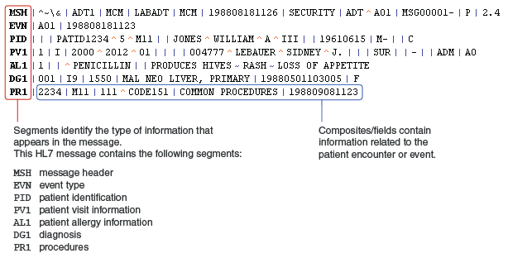
Version 2
backward compatible
encoding syntax based on segments (lines) and one-character delimiters

Slide 9
Version 2
CHALLENGES
Lack of consistent application data model which is only implied in the v2 standard
Lack of formal methodologies to model data elements and messages
.
Lack of well-defined application and user roles
Still widely accepted as standard in USA
“Loose and optional ridden” HL7 definitions lead to discrepancies in HL7 interfaces
Not inclusive of international needs
No compatibility with HL7 V3
Defining a detailed list of items to be discussed and negotiated before interfacing can occur is required
Application vendors do not support the latest and best- defined versions of HL7.

Slide 10
Version 3
HL7 v3 | More of a "true standard” and less of a "framework for negotiation" Model-based standard provides consistency across entire standard Application roles well defined Much less message optionality Less expensive to build and maintain mid-to-long term interfaces Many decades of effort over ten year period reflecting “best and brightest” thinking | For clinical interface specialists: No compatibility with HL7 V2 Adoption will be expensive and take time Long adoption cycle, unless strong business case or regulatory requirement changes Retraining and retooling necessary Applications will have to support both V2 and V3 in the foreseeable future

Slide 11
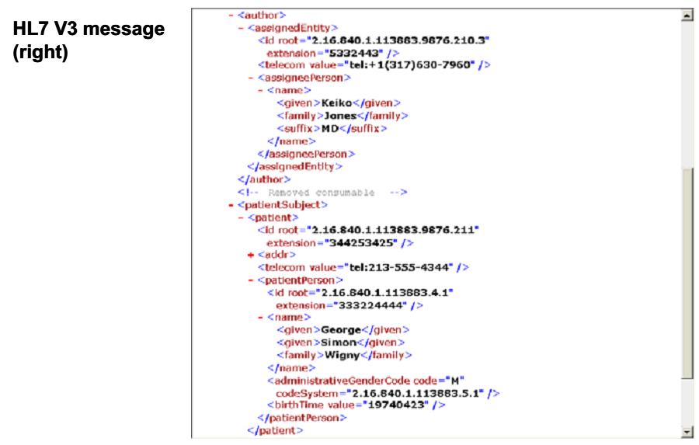
Version 3

Slide 12
FHIR
Fast Healthcare Interoperability Resources
consumable but robust
using open Internet standards
Its semantically interoperable
Easier to implement because,
RESTful APIs
HTML, CSS- UI integration
XML/JSON – Data Representation
Notes:
Using an easily consumable format for the standard avoids the need for complex custom tooling.

Slide 13
RESTful APIs
light-weight interfaces that allow for faster transmission
faster development cycles through their simpler structures
closely resemble the operation of a relational database
four basic design principles of
i) using HTTP methods explicitly
ii) being stateless
iii) exposing directory-structure like URIs to resources
iv) transferring XML or JSON or both as resource representations

Slide 14
About Resources
key entities involved in healthcare information exchange
It has the following attributes-
Resources should have a clear boundary, that matches one or more logical transaction scopes.
Resources should differ from each other in meaning, not just in usage (e.g., different ways to use a lab report should not result in different resources).
Resources need to have a natural identity.
Resources should be very common and used in many different business transactions.
Resources should not be specific or detailed enough to preclude support for a wide range of business transactions.
Resources should be mutually exclusive.
Resources should use other resources, but they should be more than just compositions of other resources; each resource should introduce a novel content.
Resources should be organized into a logical framework based on the commonality of the resource and what it links to (see resource framework below).
Resources should be large enough to provide meaningful context; resources that contain only a few attributes are likely too small to provide meaningful business value.

Slide 15
The Epilepsy Example
FHIR SAMPLE DATA

Slide 16
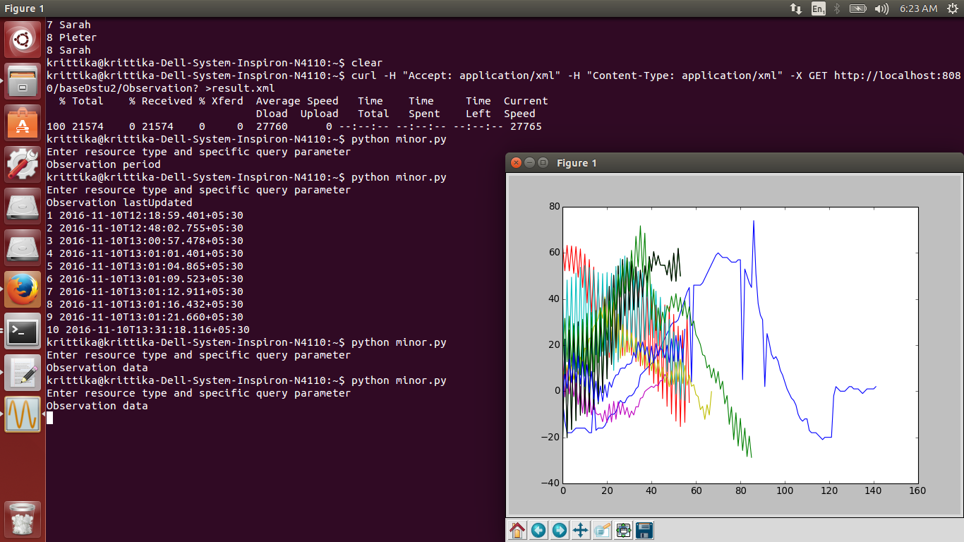
The Epilepsy Example

Slide 17
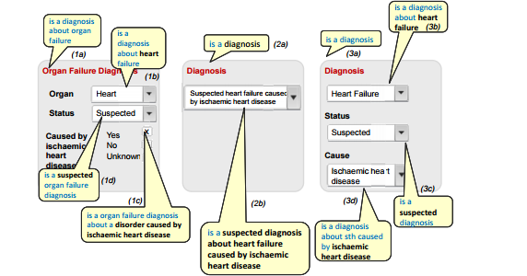
Semantic Interoperability in fhir

Slide 18
Conclusion and Future Work
fill the gaps that exist with the standards in use today
opportunity to accelerate health care data interoperability across a wide range of currently disparate systems
running machine learning and using data mining for exploratory research
Improve health care quality, increasing patient access and use of health information and improving outcomes.

Slide 19
Thanks

